Slide 1
Wisabi Bank ATM Transactions Report
Time Period from January to December 2022

Slide 2
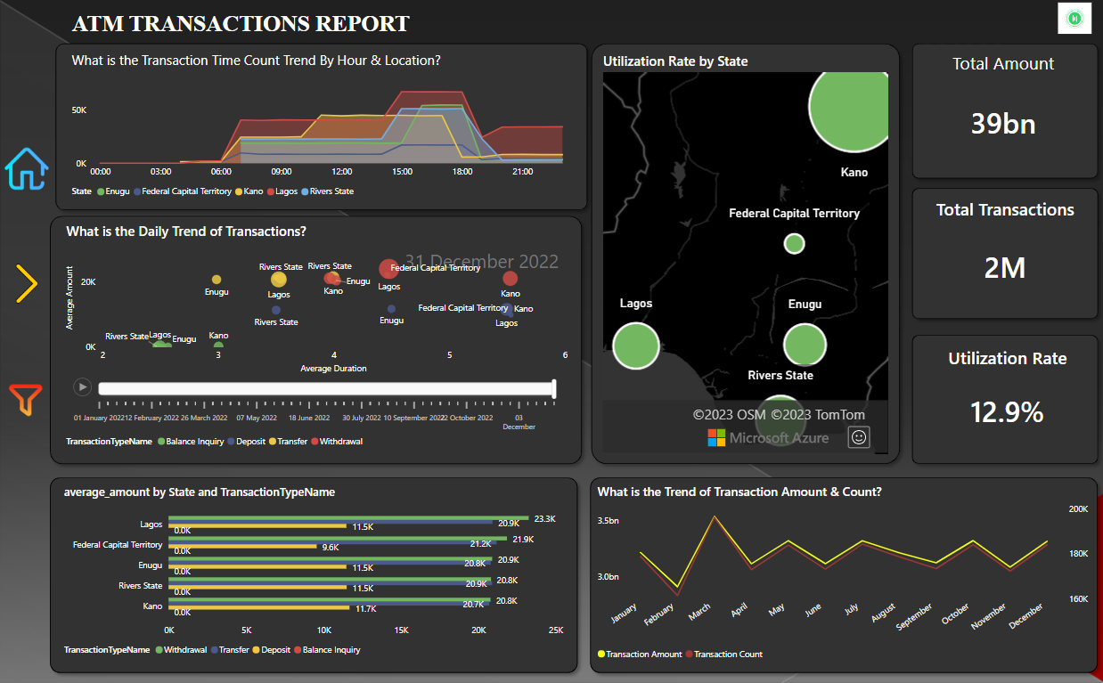

Slide 3
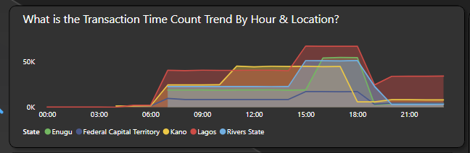
Daily Transaction Trend
ATM Transactions in Lagos increase gradually from 6 am and peaks between 3 and 7 pm.
Similar behavior is seen across other states however transactions peak earlier in Kano (around 11 am) and this is sustained till about 5 pm after which activity sharply declines.
Compared to other states, Lagos has significant transactions activity after 7 pm.

Slide 4
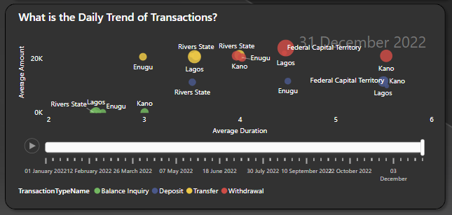
Average Amount vs Average Duration
Kano also has the longest transaction duration for Balance Inquiries and Transfers
Withdrawals have the highest transaction amount on average as expected. Withdrawals and Deposits have longer transaction duration on average while Balance Inquiries have the least transaction duration.

Slide 5
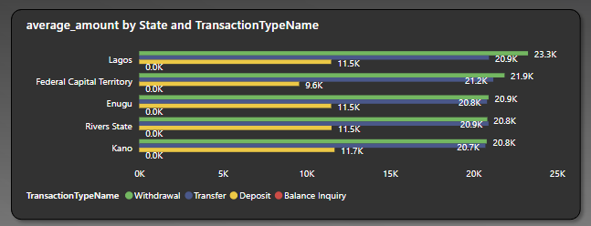
Average Transaction Amount
On Average, Withdrawals have the highest transaction amounts across all states, next is Transfers, with Deposits have the lowest.
Across all locations, The FCT has comparatively lower Deposit amounts on Average

Slide 6
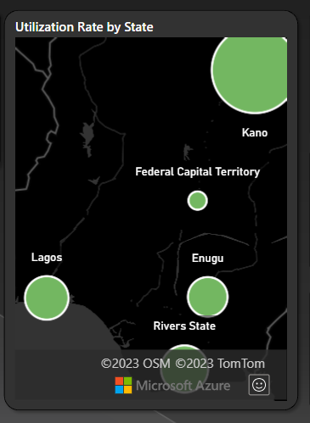
Utilization Rate
ATMs in Kano have the highest Utilization Rate (18.6%)
Rivers & Lagos have Utilization Rates greater than 12% (12.7% & 12.2% respectively) while that for Enugu is 11.6%
The FCT has the lowest Utilization Rate (8.5%)

Slide 7
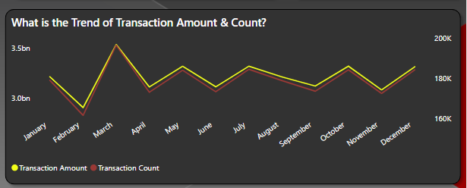
Trend of Transaction amount & count
We had the highest number of transactions and transaction amount in March
Other months with high transaction activity include January, May, July, October, and December
We had the lowest number of transactions and transaction amount in February

Slide 8
₦38,555,885,000
Total amount processed by Wisabi ATMs in 2022
2,143,838
Number of Transactions Processed
12.9%
Utilization Rate

Slide 9
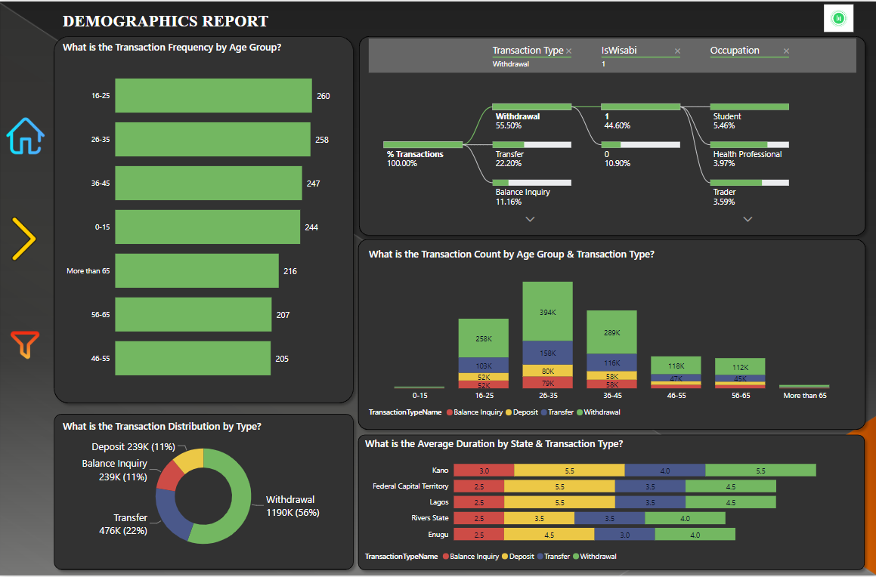

Slide 10
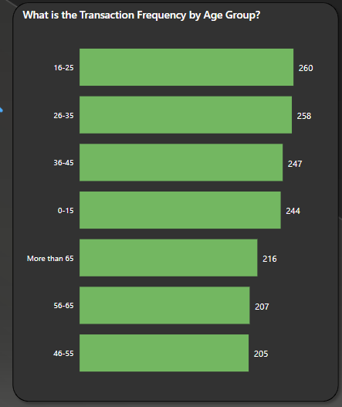
Transaction Frequency
Customers between 15-25 years have the highest transaction frequency (260).
Interestingly, customers above 65 years have a higher transaction frequency (216) than the 56 - 65 & 46 - 55 age groups (207 & 205 respectively).

Slide 11
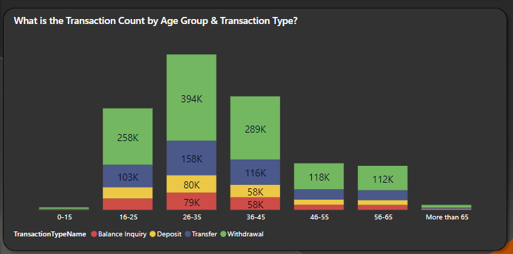
Transaction Count
Across all Age Groups, Withdrawals is the common transaction type (>50%), followed by Transfers (>20%)
Interestingly, Deposits & Transfers account for a significant amount of transactions (>10% each) across all Age Groups

Slide 12
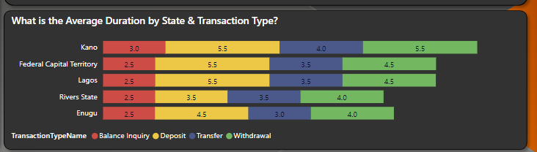
Average Transaction Duration
Across all locations, Withdrawals has the longest duration on average.
Kano’s average Withdrawal, Transfer, and Balance Inquiry durations are comparatively higher than other locations.
Rivers & Enugu have lower average transaction duration for Deposits, Transfers, & Withdrawals when compared to other locations.

